Slide 1
Week 15 Presentation
By J. Jedediah Smith

Slide 2
Summary
Trying to compare:
Classifier programs
Long vs short vs contig read classification
QC vs No QC
Programs to use:
Kraken2
Centrifuge
CCMetagen
BugSeq

Slide 3
Kraken 2
Contigs
Centrifuge
Quality Control
Short +
Contigs
Raw Short Reads
No Quality Control
CCMetagen
Raw Long Reads
BugSeq
Long +
Contigs

Slide 4
Kraken2
Conda will sometimes install an out-of-date version of Kraken2, which causes problems.
Uses FTP for downloading the references databases, which has security concerns and will not actually work with NCBI.
Must modify base Kraken2 files to fix?
Stuck on a “cannot find taxo.id file” that is clearly there.
Possibly related to a memory error?
I tried other suggested fixes, but they did not help

Slide 5
CCMetagen
No internal commands to install reference database
Reference databse must be downloaded externally through browser then moved over to server
wget does not work, website server blocks it for some reason
Stuck on a “Cannot allocate RAM error” despite the server having enough RAM and setting the SBATCH header to use a reasonable amount of RAM.
Newer program so there is not a lot of support or help threads.

Slide 6
Centrifuge
Errors when trying to download databases.
Looked like it was also using FTP to download NCBI stuff, was developed by some of the same people.
We put this on the backburner to focus on the other programs

Slide 7
BugSeq
Cloud-based and easy to use, just drag and drop files and tell what type of data.
Started as just long-read data, but now can also use short-read.
Only works with raw reads, not contigs
Sent results within 6 hours each time I used it.
Free for academic research
Paid arrangements available with more options
Custom reference databases, etc
No errors using it.

Slide 8
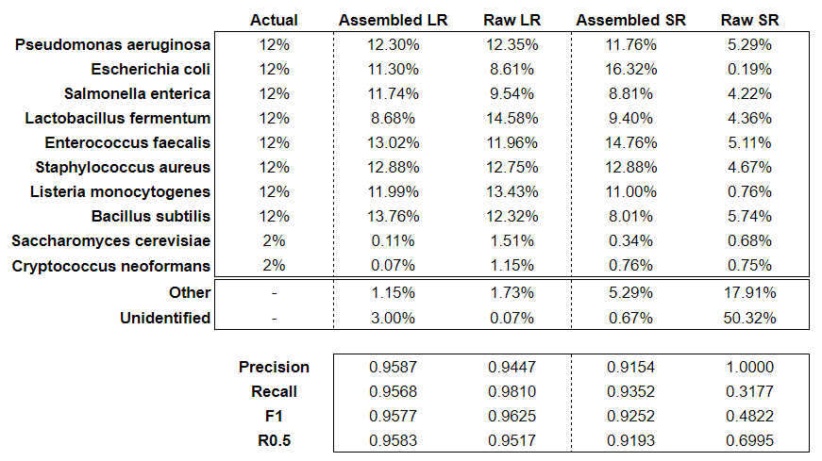
BugSeq Comparison
Raw short-read mode is still experimental.
Doesn't use Basyian redistribution like Bracken, reads are assigned to lowest common ancestor
Not intended to be used for abundance estimates
So bad at identifying species, I used the genus instead

Slide 9
Conclusions
Long read results are the best
Assembling contigs can boost short read data with good results
Not quite as good as long read
Can be detrimental if used on long read
Raw short read data will work but probably not as good as the rest?

